Slide 1
Tukes' inspection theme 2013-2014: Process safety managament

Slide 2
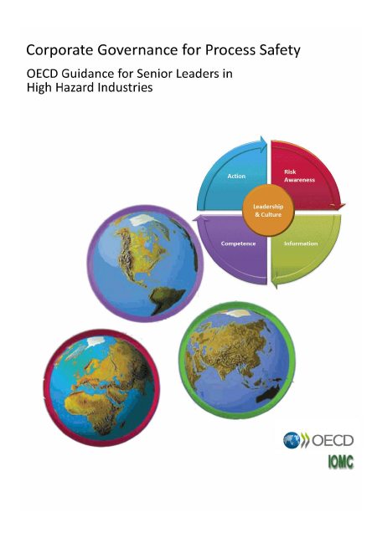
Targets
To emphasize the importance of process safety
To activate companies in process safety-related issues

Slide 3
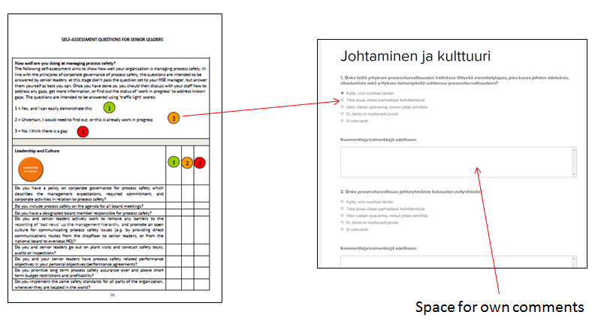
Realization
OECD self-assesment questions were translated into finnish

Slide 4
Realization
Self-assessment made online, summary of answers sent automatically to respondent and to inspector
Interviews of workers – comparison to management’s answers
Other discussions during the inspection

Slide 5
180 answers in total

Slide 6
Do you have a policy on corporate governance for process safety which describes the management expectations, required commitment, and corporate activities in relation to process safety?
Tukes’ observations:
Process safety has lately been in the focus more than before, but there is still need for further improvements in many plants
Many operators believe that certified systems also guarantee the management of process safety
Safety culture is promoted in many ways, for example:
management takes part in safety walks
personnel is encouraged to express their concerns related to safety
Notes:
Occupational safety is still strong

Slide 7
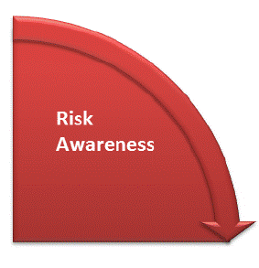
Do you have a management of change (MOC) process to assess changes for process safety impacts arising from modifications?
Tukes’ observations:
MOC procedures have developed concerning small changes as well
Finding suitable risk assessment procedures and updating the assessments is a challenge

Slide 8
Do you have a full suite of current process safety performance indicators appropriate to the level of risk of your site, including information on the prevalence of deficiencies or dangerous trends which could lead to a major accident?
Tukes’ observations:
Many companies are targeting on developing suitable process safety indicators
Safety management systems (SMS) are in order, but is process safety sufficiently taken into account?

Slide 9
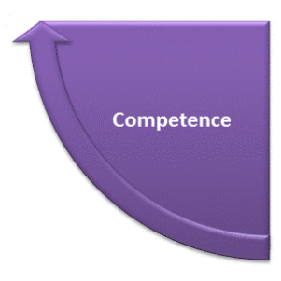
Do you have effective process safety competency requirements for all personnel with process safety impacts, including you and senior leaders?
Tukes’ observations:
Does management understand the risks involved in the operations?
Does the staff have required competence and receive training regularly?

Slide 10
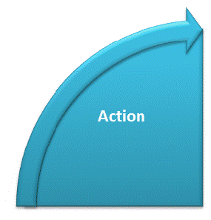
Do you ensure that sufficient resources are available and review progress againts the process safety improvement plan?
Tukes’ observations:
Have the companies found the correct issues to their improvement plan regarding process safety?

Slide 11
Thank you for attention! Contact: sara.lax@tukes.fi

