Slide 1
Accident Analysis Benchmarking Exercise Team 6 Presentation
Maureen Wood
Major Accident Hazards Bureau

Slide 2
Presented on behalf of Team 6
1) JX Refinery Sendai
Accident description: The 2011 tsunami in Japan caused multiple release of flammable hydrocarbons from tanks and pipelines, that ultimately ignited. Four people were killed.
Methods used:
Phase 1–Sequence of events: STEP
Phase 2–Direct causes: Fault Tree Analysis (FTA), Event Tree (ETA) Analysis, MTO
Phase 3–Indirect causes: Fault Tree Analysis (FTA), Event Tree (ETA) Analysis, MTO
2) Cosmo Oil Refinery
Accident description: The 2011 earthquake (preceding the tsunami) resulted in several explosions and extensive fire following the release of LPG.
Methods used:
Phase 1 – Sequence of events: STEP
Phase 2 – Direct causes: Event and Causal Factors Charting
Phase 3 – Indirect causes: Barrier Analysis on a Tier-Based Sorting
Participants: Anirban Chakraborty, Ahmed Ibrahim, Bohuan Zhao, Kana
Minamide, Songwhan Han and Yuhan Gao, supervised by Ana Maria Cruz

Slide 3
Comparison of methodologies (JX refinery
Method Advantages Disadvantages

Slide 4
Main messages about each method
General (JX Refinery accident)
MTO analysis and STEP analysis are basically superior compared to Fault tree and Event tree analysis in terms of cause analysis and sequence of accidents.
However each methodology is not perfect and has to be redeemed
with other methodologies in order to evaluate accidents precisely and concretely. Therefore, a comprehensive methodology which contains advantages of MTO and STEP is required.

Slide 5
STEP
The STEP model is easy to show the track of accident events clearly.
However, the model only focuses on events. The STEP does not have a way to point out the interrelation or cooperation between each actor, which makes it hard to indicate the cooperation problem, such as lack of communication in the JX Refinery case.
As a result, if the investigator does not have sufficient knowledge of the specific accident, the reason for safety problems could not be recognized.

Slide 6
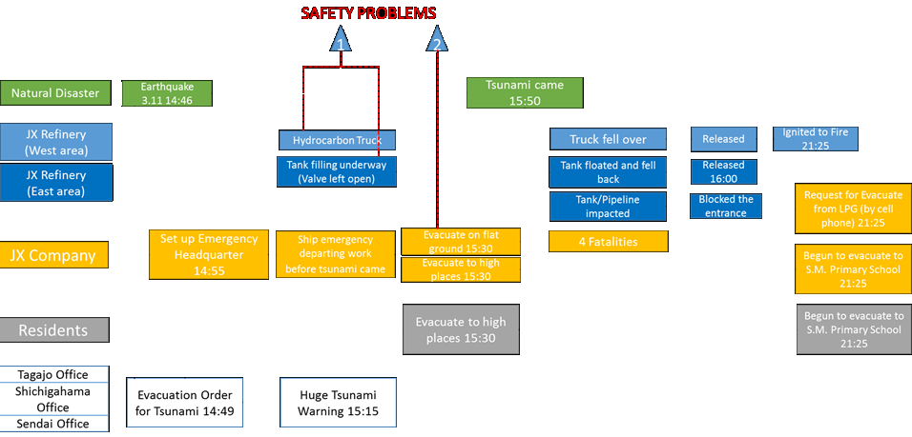
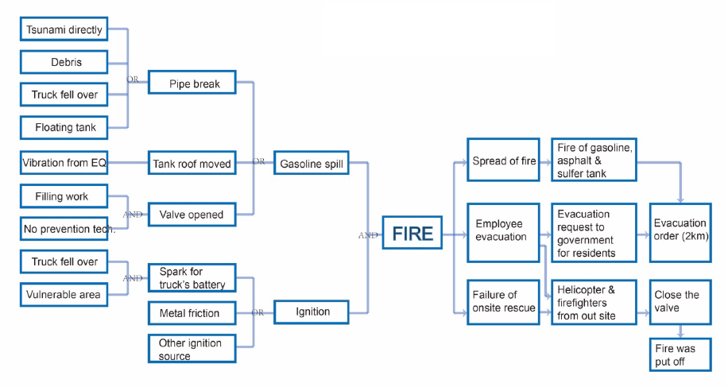
STEP diagramme for JX Refinery accident
Fault tree diagramme of JX Refinery accident

Slide 7
MTO diagramme of JX Refinery accident

Slide 8
Main impressions - (Cosmo refinery accident analysis)
Event and Causal Factors Charting
Barrier Analysis
Root Causes on a Tier Based Sorting
Many analysis methods give great structure for building, analyzing and digging into the root causes of accidents,
However, the case with Cosmo refinery fires is quite straight forward since events are more in series than parallel.
Thus, we thought that using any of the advanced analyzing methods would be quite like forcing events and incidents to fit into blanks rather making a real good use of it.
A simple technique that allows us to free sketch and list out thoughts was thought to be more useful allowing a decent margin of freedom and also reduces the struggle of fitting other methods criteria

Slide 9
Event and Causal Factor Charting is an elegant way to point out the underlying causes.
The Barrier Analysis points out the importance of the safety valve in the entire process that happened after the uninterrupted release of LPG.

Slide 10
Root Cause Analysis on a Tier-Based Sorting
The root cause analysis supported 3 main outputs:
(Failure to adhere to regulatory procedures, the importance of considering a Natech scenarios, the absence of good management)

Slide 11
Final impressions (Cosmo refinery accident analysis)
The selected investigation methods for Cosmo refinery seem to fit the nature of the accident.
Important to note that listing approaches may cause confusion if the accident contains many simultaneous events. Use of charting methodologies can be much more convenient in such cases.
Although the analysis seems to be sufficient from the point of digging into root causes and handling the facts, it doesn’t force the analyst to consider a further domain of the accident.
      For instance, evacuation on both levels of the facility and the nearby vicinity which we think is a gap in our analysis, for a lack of information about evacuation on both sides.

Slide 12
Thank you for your kind attention!
Please come visit the Minerva web platform for resources on chemical accident risk reduction
https://minerva.jrc.ec.europa.eu/en/minerva

