Slide 1
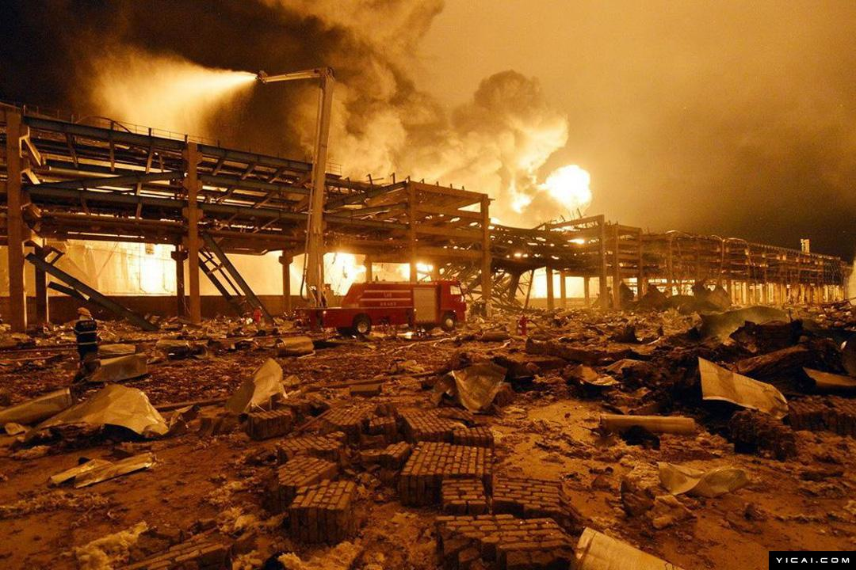
Accident Analysis Benchmarking Workshop 2018
Events sequence diagram /
Bow Tie / AcciMap
Qiaoling Chen | Tsinghua University, China | cqlsff1995@163.com
Zhanpeng Zhang | Tsinghua University, China | zzp14@mails.tsinghua.edu.cn
Jinsong Zhao | Tsinghua University, China | jinsongzhao@tsinghua.edu.cn

Slide 2
Introduction
Accident: The fire and explosion accident of the Ruihai hazardous goods warehouse at Tianjin Port occurred on 12 August 2015 was an extremely serious accident related to work safety issues, which revealed a series of safety management and supervision defects.
Phase 1 (Chronology): Events sequence diagram
Phase 2 (Direct Causes): Bow Tie
Phase 3 (Underlying Causes): AcciMap

Slide 3
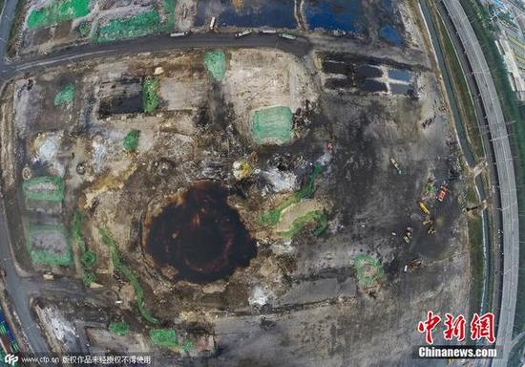
Phase 1 (Chronology):
Events sequence diagram
We used events sequence diagram to clarify the process of accident, including the information about timeline, explosion and emergency response.
Events sequence diagrams only show facts chronologically.
The explosion pit was considered to be the main centre of the explosion. (diameter: 97 m; depth: 2.7 m)

Slide 4
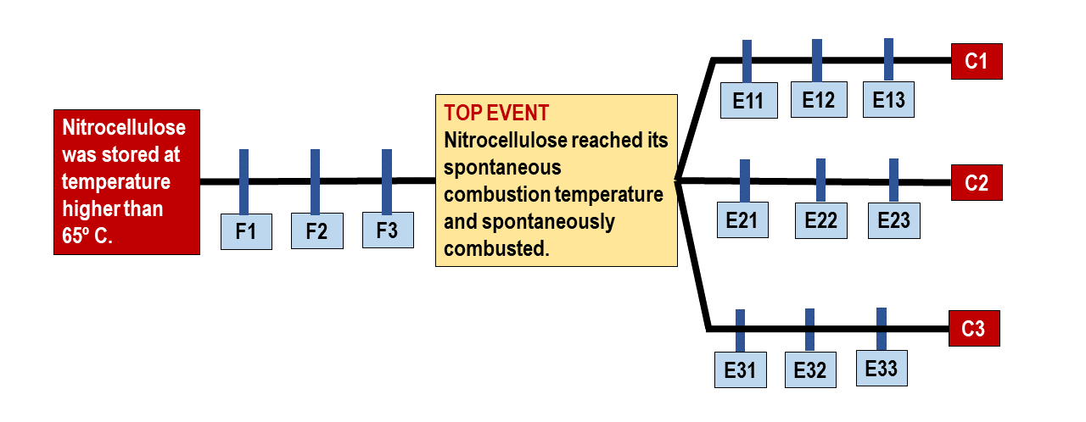
Phase 2 (Direct Causes): Bow-tie
Bow-tie: Fault Tree Analysis + Top Event + Event Tree Analysis
Strengths: Chronology; Failed barriers / Direct causes ; Graphical output with clear structures
Weaknesses: Possibility of omitting some underlying factors (such as organizational factors in the Tianjin accident)
User-friendliness: Easy to learn / to operate / to understand; a Great tool for those accidents with relatively simple causes
Find the Top Event is a crucial step.
Notes:
The Fault Tree is on the left side of the top event, which depicts the prevention barriers which prohibit threats from resulting in the top event. It describes the process of the accident and the interrelationships among them^{[5]}.The Event Tree is on the right side of the top event, which represents the barriers that prevent and mitigate the top event from escalating in to undesirable consequences. It shows how the event may generate different casualties and describes all possible consequences^{[3,5]}. The bow-tie analysis result is shown in Fig.2, and the failed barriers are framed.

Slide 5
Phase 3 (Underlying Causes): AcciMap
AcciMap: 6 Levels including factors of government policy, regulatory bodies, company management.
Strengths: Comprehensive analysis involving the management and supervision level.
Weaknesses: The chronological order of events is not clear. The Graphical output may be too complicated.
User-friendliness: Easy to learn, but difficult to operate / to understand; a better tool for those accidents with complex causes (especially involving the management and supervision level)
Helpful for developing countries to improve their safety management
Notes:
The Accimap approach was developed as a means of modeling socio-technical context to identify the combination of events and decisions that result in an accident, especially focusing on failures across the following six organizational levels
Bow-tie analysis places emphasis on the direct technical causes and consequences before and during the accident. If deeper level causes, especially in the management and supervision level were not disclosed, lessons could not be learned well so that similar accidents may still happen in the future.

Slide 6
Thank you for your attention!
Qiaoling CHEN
Tsinghua University, China
Email: cqlsff1995@163.com

