Slide 1
Event Analysis Methods
Yves Dien
EDF R&D, yves.dien@edf.fr
CHAOS, yves.dien@hotmail.fr
Nicolas Dechy
IRSN, nicolas.dechy@irsn.fr

Slide 2
Assumption 1
Appropriate investigation/analysis is of upmost importance in term of safety (improvement)
  We can learn from our own failures / errors
Need to figure out
  What actually went wrong
  Why it went wrong

Slide 3
Assumption 1 (c'td)
  “Many accident investigations do not go far enough. They identify the technical cause of the accident, and then connect it to a variant of “operator error” […]. But this is seldom the entire issue. When the determinations of the causal chain are limited […], typically the actions taken to prevent a similar event in the future are also limited […]. Putting these corrections in place leads to another mistake – the belief that the problem is solved.”
    CAIB report p. 97, 2003 (emphasis added)

Slide 4
Assumption 2
Investigation method used will depend on vision about event occurrence
  An exceptional set of unfortunate circumstances in an isolated case
  "Act of God"
  (Unforeseeable) residual risk
  "Normal accident" (in the sense of Charles Perrow)
  Consequence of failures (to investigate, analyse and remedy)

Slide 5
Assumption 2 (c'td)
Operator(s) action(s)/“error(s)”
NB: Either S1, S2, S3 or S4 leads to the event
EVENT
Technical failure
P/ROF = Pathogenic
Resilient
Organisational
Factors
ROF_{i}
POF_{i}
POF_{n}
= (Small) events [(weak) signals] not detected as symptoms of deterioration of the situation
EVENT
(“organisational accident”)
Pre Event Situation
Time for prevention
Post Event Situation
Crisis Management

Slide 6
Few (selected) ANALYSIS METHODS
The "most well known"

Slide 7
Causal tree analysis
Causal tree (France, INRS, 70’s)
Method principles (1/2)
  To develop an objective understanding of the process which led to the accident (versus to determine accountability/responsibility)
  To highlight facts and no interpretations nor value judgments
  To take account of facts as upstream as possible about “accident genesis” with a deductive approach

Slide 8
Cause tree analysis (c'td)
Method principles (c'td)
  To respect steps sequence, especially step “data collection and causal tree construction” and step “actions proposals”
  To use an observation framework which is related to the work situation in a simplified manner
    Individual: operator(s), employee(s), worker(s), victim(s),…
    Task/Activity (actual work): actions which have contributed to accident
    Equipment(s) used: tools, material(s), product(s),…
    Accident surrounding: work spaces, physical and psychological environments,…

Slide 9
CausAL tree analysis (c'td)
Data Collection
  2 types of information sources
    From Work environment
    From Interviews
  Code of ethical conduct for interview
  Data to be collected: FACTS
    Fact = information, state, value,..
    Fact ≠ interpretation, opinion, value judgments, “negative facts”, …
      e.g. He/she worked while he/she wore sport shoes is a fact
      He/she did not wear his/her protective footwear is NOT a fact
Starting point of analysis is the event (how to define event)

Slide 10
CausAL tree analysis (c'td)
Example of a "causal tree"
  A farm worker has to hitch a trailer Ti to a tractor Tc1. Tc1, the usual tractor is out of order. Worker decides to use tractor Tc2 that he does not usually drive. Yet, Tc2, contrary to Tc1, has a height difference with the trailer connecting device. So, coupling becomes uneasy. Therefore, worker places himself between Tc2 and Ti in order to lift Ti and to achieve hanging. But Tc2 parking brake has not been applied and because its engine was still running, it is subject to jarring. Moreover, ground is sloping. It leads that Tc2 moves back (unexpectedly) and that the worker, “stuck” between Ti and Tc2, is injured.

Slide 11
CausAL tree analysis (c'td)
Example of a "causal tree"
Tc1 out of order
Tc2 unusual
Height difference between Tc2 and Ti
Difficult coupling
Worker between Tc2 & Ti
Brake off
Worker “stuck” between Tc2 & Ti
Injury
Tc2 Engine on
Tc2 “shakes”
Tc2 moves back
Sloping ground

Slide 12
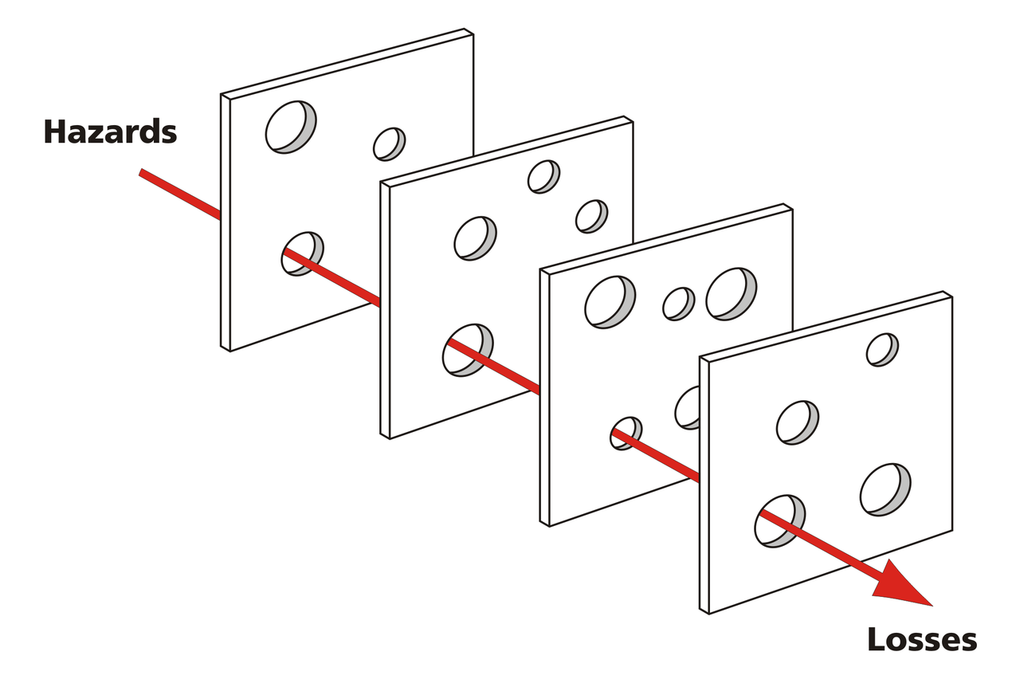
Barrier analysis
Barriers
Goal
  To identify hazards linked to an event and barriers (and controls as well) which led to it
Focus on
  Performance of barriers in place
  Barriers not used
  Missing barriers
  Barriers which need evolved
Types of barriers
  Physical: Equipment and engineering design, Safety devices, Protective clothing, Warning devices…
  Management: Hazard analysis, Knowledge/skills, Line management oversight, Training, Work planning, and procedures…

Slide 13
Barrier analysis (c'td)
A several steps analysis
  Step 1: Identify the hazard and the target.
  Step 2: Identify each barrier.
  Step 3: Identify how the barrier performed
  Step 4: Identify and consider probable causes of the barrier failure
  Step 5: Evaluate the consequences of the failure in this accident

Slide 14
Barrier analysis (c'td)
Barrier Analysis sheet
Hazard | Target
(required) Barriers Identification | Performance of Barriers | Cause of Failure (if any) | Effect on the event occurrence

Slide 15
CHANGE analysis
Goal
  To figure out every change (planned and unplanned that led to the event occurrence
Change analysis can be seen as a "first step" of another method
  Not a "self-supporting" method
Change analysis is a process
  Impact of changes on event occurrence

Slide 16
CHANGE analysis (c'td)
Change Analysis Process
Description of accident situation
Impact on Accident Analyse differences
Comparaison
Identification of differences
Description of comparable accident-free situation
Results as input into events chart

Slide 17
MTO
(Hu)Man, Technology and Organisation Analysis
The MTO-analysis is based on three methods:
  Structured analysis by use of an event tree.
  Change analysis
  Barrier analysis (technological and administrative barriers)
Identification of failure causes based on a checklist (10 items)
  Organisation, Work organisation Work practice, Management work, Change procedures,Ergonomic / deficiencies in the technology, Communication, Instructions/procedures, Education/competence, Work environment
Each failure cause is analysed according to its basic(root) causes
  A specific checklist for every "failure cause"

Slide 18
MTO (c'td)
Last step: definition of corrective measures
  Realistic and specific measures

Slide 19
Acci-Map
Jens Rasmussen and Inge Svedung work
More a "risk management method" rather than an "event analysis method"
Nevertheless outputs of the method useful for event analysts
  Stress on importance of decision making at every level and interaction between levels
  Stress on importance of past events analysis

Slide 20
Acci-Map (c'td)

Slide 21
MORT
MORT is a systematic method for planning, organising, and conducting a comprehensive accident investigation
MORT is a graphical checklist with generic questions that investigators attempt to answer using available factual data
Use of a colour coding for events
An extensive training (few days) is needed for performing an in-depth analysis of complex accidents

Slide 22
TRIPOD
BARRIERS
Hazards
Losses
Causes
Latent Conditions
Investigation
Unsafe acts
Local workplace factors
Organisational factors
James Reason work
Organisational failures are the main factors in accident occurrence
Event is generated by mechanisms resulting from decisions mechanisms result from decisions: the Basic Risks Factors (BRF)
BRFs are latent failures
"Generic" factors have"specific" impacts (at "lower levels)
11 BRFs
  Design, Tools and Equipment, Maintenance Management, Housekeeping, Error Enforcing Conditions, Procedures, Training, Communication, Incompatible goals, Organisation, Defences
TRIPOD Beta: computer tool making a representation of the event

Slide 23
TRIPOD (c'td)
Barriers breached
Decision makers
BRFs but Defence
Psycho. Pécursors
Substandard acts
Operational Disturbance
Accident
Consequences
Defences
TRIPOD model

Slide 24
The FRAM
Erik Hollnagel work
The Functional Resonance Analysis Method
  Functional variability
Basic principles
  Principle of Equivalence of Successes and Failures
  Principle of Approximate Adjustments
  Principle of Emergence
  Principle of Functional Resonance

Slide 25
The FRAM (c'td)
Steps of Analysis
  Description of the event
  Description of what should happen The description is basically the set of functions that are required for everyday performance to succeed (data from daily work rather than data from event investigation)
  Characterising the variability (previous step is the FRAM model)
  Use of more specific information (e.g., an event analysis) to propose more instantiations of the model
  Analyse of instantiations to find an explanation why something happened
The FRAM Model Visualiser (FMV): a software tool for building a model and automatically creating a graphical representation of a FRAM model

Slide 26
STAMP
Nancy Leveson work
STAMP: System-Theoretic Accident Model and Processes
Based on systems theory, not reliability theory
Accidents causes: dynamic control problems (vs. a failure problem)
  Example of control problem: O-ring did not control propellant gas release by sealing gap in field joint of Challenger Space Shuttle
Taking into account
  The whole socio-technical system
  Interaction between elements
  Errors (e.g. design errors, human errors)

Slide 27
STAMP (c'td)
Assumption
  Accidents occur when interactions between system components violate constraints related to their behavior
Goal is to control the behaviour of the components and systems to ensure safety constraints are enforced
  Example of safety constraint: Power must never be on when access door open

Slide 28
STAMP (c'td)
Occurrence of accidents is complex
  How to cope with complexity
    Analytic Reduction: system division into distinct parts (physical components separation and distinction of event over time for behaviours
      Separation possible and no distortion of phenomena (each component has to operate independently)
    Statistics system seen as a structureless mass with interchangeable parts
      Treatment of components behaviour (supposed regular and random enough) in terms of averages

Slide 29
Organisational analysis
Assumption
  Any event is generated by direct or immediate causes (technical failure and/or “human error”), NEVERTHELESS, its occurrence and/or its developing is considered to be induced, facilitated or accelerated by underlying organisational conditions (complex factors)
Definition (attempt)
  OA intends to explain, to put in obvious place some processes and phenomena within organisation in following a specific goal: analysis of an event, with a perspective of improvement of safety

Slide 30
Organisational analysis (c'td)
OA Dimensions
  Historical dimension: going back in time (“upstream”) for comprehending and analysing processes and trends that led to the event/situation and, meticulous examination of past events
  Transversal dimension (organisational network): Connections and interaction between “entities” involved (beyond a single company). Organisational network is not an organisational chart
  Vertical dimension (part of organisational network): Interactions between "hierarchical levels" (relations between “field operators”, experts and management) – Focus on Mode of co-operation, Mode of communication, Information flows, Different (?) visions of the world…

Slide 31
Organisational analysis (c'td)
Organisational Vertical dimension
Top Management
Space of analysis
ANALYSIS “WITHIN” ORGANISATION THICKNESS
Experts
Field Operators
Organisational
Structure
Organisational Transversal dimension
Time
INCUBATION PERIOD
Historical dimension

Slide 32
THANK YOU FOR YOUR ATTENTION

