Slide 1

ESReDA Results from study of accident investigation practices, models and methods
Nicolas DECHY
Yves DIEN
Ana Lisa VETERE ARELLANO
Frank VERSCHUEREN
on behalf of the ESReDA Projects Groups
MAHB benchmarking exercise on
Accident Investigation/Analysis and Reporting Lessons Learned
JRC, Ispra, Italy, 05-06th November 2015

Slide 2
What is ESReDA?
European Safety Reliability and Data Association
Created in 1992 (merge EuReDatA (73) + ESRRDA (86))
Promotes cross-sectorial exchanges, R&D and applications in RAMS
From 35 to 50 members (companies, institutes, Univ,…)
2 Seminars per year (50th in 2016)
Project Groups (PG):
  Former: uncertainties, ageing, reliability of structures, maintenance, asset management,… and the « accident PGs »
  Current: fire risk analysis, wind turbines, optimisation of life cycles cost, critical infrastructures, foresight in Safety

Slide 3
ESReDA PG on Accident Investigation and lessons learning
1993-2000: Accident Analysis
2000-2008: Accident Investigation
2009-2015: Dynamic Learning as a follow-up of the lessons learned from accident investigation
2015: Foresight in Safety
Focus shifted
➔ from storing lessons adequately in databases
➔ to the quality of investigation that feed databases
➔ to the quality of lessons learning after the accident
➔ to the efficiency of learning before the accident

Slide 4
ESReDA Seminars on Accidents
Accident analysis
  1994, JRC, Ispra, 7th
Learning from accident investigation and emergency response
  1995, Erlangen, 9th
Accident database as a management tool
  1998, Antwerpen, 15th
Safety investigation of Accidents
  2003, JRC, Petten, 24th; Special issue in Journal of Hazardous Material 111, 2004
Future challenges of accident investigations
  2007, JRC, Ispra, 33rd ; Special issue in Safety Science Journal 50, 2012
  Lessons Learned from Accident Investigation
  2009, EDP Coimbra, 36th
  Dynamic Learning from Incidents and Accidents, Bridging the Gap between Safety Recommendations and Learning
  2013, EDP, Porto, 45th

Slide 5
ESReDA PG Deliverables on Accidents
  Accident database guidance, benchmark
    90’s, paper report, ESReDA-DNV publishing
  Inquiry on accident investigation practices in Europe
    2003, paper report, ESReDA-DNV publishing
  Shaping public safety investigation of accidents
    2005, book, ESReDA-DNV publishing
  Guidelines for safety investigation of accidents
    2009, report, free to download
  Case study analysis on dynamic learning from accidents – The ESReDA Cube, a method and metaphor for exploring a learning space for safety
    2015, report, free to download
  Barriers to learning from incidents and accidents
    2015, report, free to download
  Training toolkit: learning from incidents and accidents
    2015, report, free to download

Slide 6
Global Aim of the PGs on Accident
  Best practices (and also from failures) ➔ learning across sectors and EU countries
  Foster harmonisation in EU
  Common definitions, concepts, theories, models, generic methods
  Practical and theoretical advice
  State of the art and future challenges
  Safety versus blame/litigation

Slide 7
Target Groups
  People who conduct investigation
  People who orders investigation
  Responsible person who are supposed to learn
  Learning from experience analyst (e.g. database analyst), manager
  Assessors, reviewers (auditor, inspector, regulator)
  Victims and relatives
  Researchers
  Teachers, trainers

Slide 8
Accident investigation practices in EU
  State of the art: 49 EU answers in 2001-2002
  Findings
    High impact of regulation to launch investigation: e.g. Seveso, Appendix VI, criteria for major accident report to Control Authority (that transfers to MARS), no independent investigation required;
    Members of inv. : internal (different levels), no expert in Acc. Inv. or learning, 9 mentioned human behaviour/reliability was a criteria
    Ad-hoc committees, 69% had a procedure, 10% international P.
    Majority mentioned no particular AI method, method recommended for 20%, 50% cause-consequence, 14 methods (8 by one org.)
    Fault tree, human error, probabilistic, some were not AI method
    Root cause (MORT, SMORT, TRIPOD) by 2 organizations ; No organisational investigation method

Slide 9
Institutional Framework
  Trends
    Increased public and victims scrutiny (confidence?)
    Regulation developments, EU harmonisation
    Ad-hoc “public” (parliamentary, administrative) inv. ➔Independent investigation board created in transportation
    Links to litigation investigation to be clarified
    Technical investigation ➔ system approach integrating human and organisational factors
  Dilemma
    “independence” versus “expertise”
    Sectorial or cross-sectorial investigation bureau/board

Slide 10
Stakeholders with different perspectives
Type of stakeholders
A) Operating Companies | B) Control Authorities | C) Public Parties
Company and the corporation Internal department in charge of Health, Safety and Occupational Conditions/ Environment Health, Safety and Occupational Conditions committees Sub-contractors and customers Insurers | Local control authorities Control authorities of local control authorities National control and regulatory authorities, Ministries and Government Police and justice (litigation and court) Labour inspectorate Fire and rescue services | Third party-expert Independent investigation board Victims’ labour associations Parliament and political parties Mass media Non-Governmental Organisations Trade unions

Slide 11
Different aims
  Several perspectives on human error (Rasmussen et al, 1984)
  Explaining an unusual event: the common sense perspective;
  Understanding human behaviour (or organizational behaviour): the scientist’s perspective;
  Evaluating human performance (or organizational performance): the reliability analyst’s perspective;
  Improving human performance (or organizational performance): the therapist’s perspective;
  Finding somebody to punish: the attorney’s perspective;
  Improving system (organization) configuration: the designer’s perspective

Slide 12
5 Key questions
  WHAT did happen?
    Evidence, facts, chronology ➔ explain
  HOW did it happen?
    Circumstances, conditions explaining causal relationships ➔ explain
  WHY did it happen?
    Root causes, complex causal relationships➔ understand, making sense of actors rationale, decisions, actions, view
  WHY it was not prevented?
    Barriers, defences lines could/should have been implemented, why did they fail?
  WHAT is recommended to prevent the recurrence of similar events?
    Here and also elsewhere

Slide 13
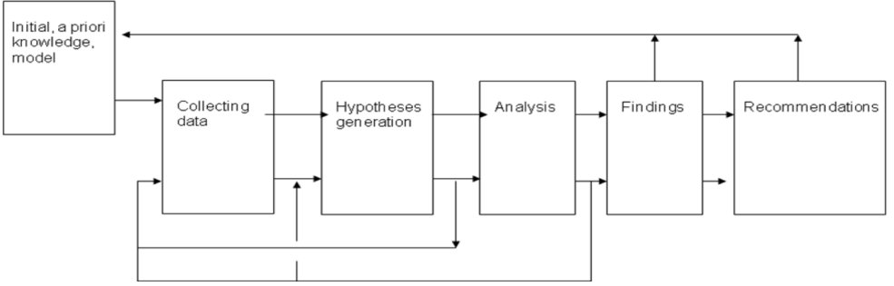
Generic Approach
  Generic principles:
    basic assumptions, protocols, coordination, competence, data and evidence, reporting, follow-up of recommendation, communication
  Common phases:

Slide 14
Background Knowledge
  What is an event?
    In-depth analyses of accidents, incidents and crises clearly showed that any event is generated by direct and/or immediate causes (technical failure and/or ―human error).
    Nevertheless their occurrence and/or their development are considered to be induced, facilitated or accelerated by underlying organizational conditions (complex factors).
    A vast majority of events can be seen as the ending point of a process of safety degradation, at the end of an incubation period (Turner 1978), during which some events and signals (weak or strong) occur, but they are not perceived and/or not treated appropriately according to their potential threat to safety.
    Life of an industrial system can be seen as continuous tension between Resilient Organizational Factors (ROF) and Pathogenic Organisational Factors (POF)
    (Dien, 2006, ESReDA 2009)

Slide 15
Event development model
Dien, 2006

Slide 16
Knowledge on safety
Perceived complexity
Period of inter
organisation
relationship
Socio technical
period
Interaction
between
Human error
Interaction
organisation
Technical
period
within
as source
period
organisation
of problems
Individuals as
as source
Technology as
source of
of problems
source of
problem
problems
1980
1990
2000
Years
TMI (1979)
Columbia (2003)
Bhopal (1984)
Paddington (1999)
Chernobyl (1986)
Challenger (1986)
Wilpert and Fahlbruch (1998)

Slide 17
Sociotechnical system
Rasmussen (1997)

Slide 18
3 Dimensions to analyse an event
Organisational
Organisational
vertical dimension
vertical dimension
Top management
Top management
ANALYSIS “WITHIN”
ANALYSIS “WITHIN”
ORGANISATION
ORGANISATION
THICKNESS
THICKNESS
Field operators
Field operators
Organisational
Organisational
Organisational
Organisational
structure
structure
transversal dimension
transversal dimension
INCUBATION PERIOD AND EVENT
INCUBATION PERIOD AND EVENT
SEQUENCE
SEQUENCE
Historical
Historical
dimension
dimension
Dien (2006)

Slide 19
Danger
Losses
Defences
Stages in the development and investigation of an organisational accident (Reason, 1997)

Slide 20
Tools for different purposes and context (Frei et al, 2003)
Scale of investigation
Sequencing method
Rigorous root
causes methods
“understanding”
“grounded theory”
Very serious
Interviewing
Tools for
forming and
testing
hypotheses
Forensic
Screening tools
Photography
Major
Structured root
causes methods
Moderate
Analytical tools for
low-to-moderate
scale investigation
Structured approached and format
Minor
Level of abstraction
Data collection
Analysis of immediate cause
Analysis of underlying cause

Slide 21
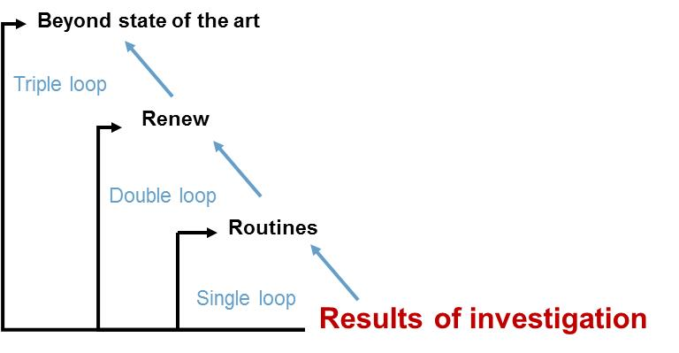
Depth of learning/change?
Degre of renewal: Optimisation ; Adaptation ; Innovation

Slide 22
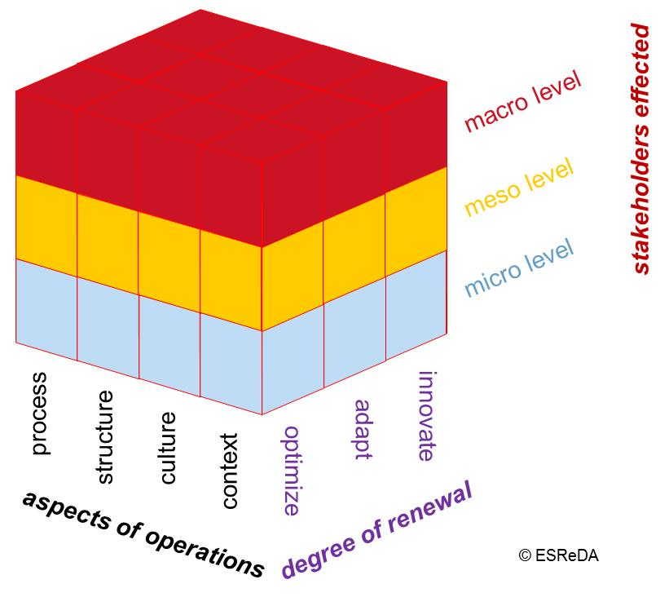
Solution space for designing recommendation
How to map the lessons learned?
How to identify unlearned lessons?
What is the depth of change?
Who is in charge?
To what part of the system does it apply?

Slide 23
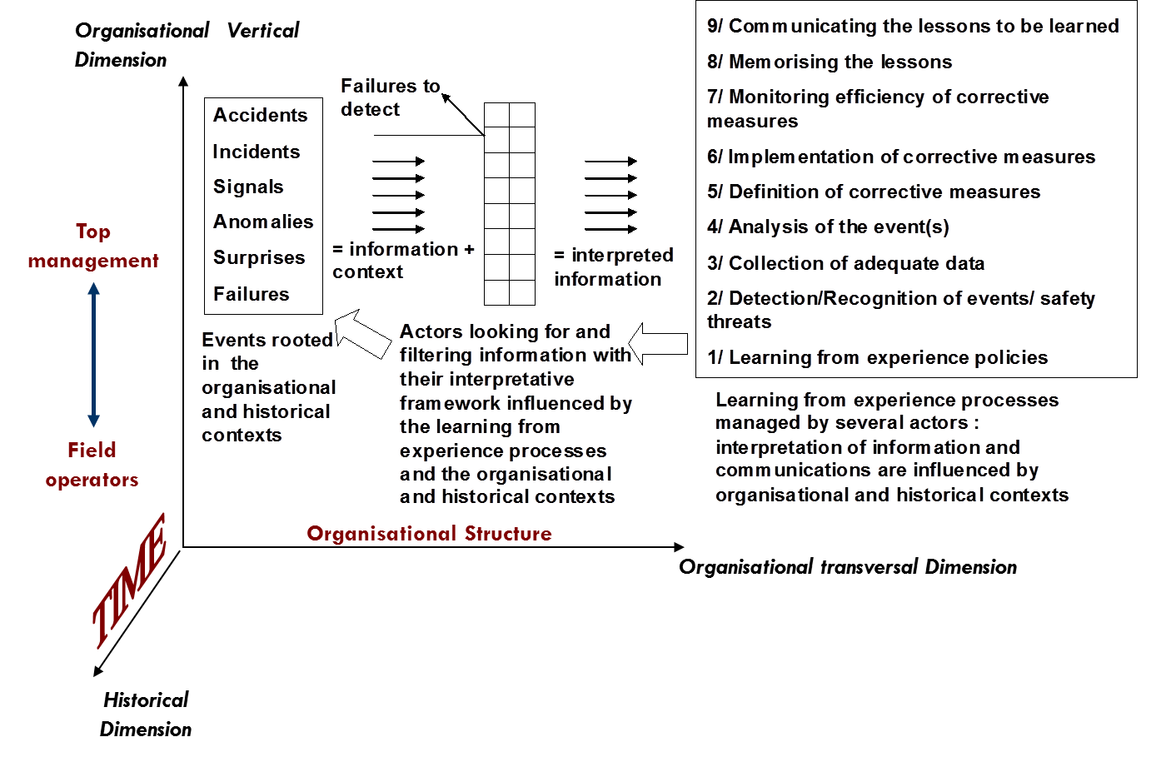
Learning process, dimensions
Issues/levers to manage but also barriers/failures at each stage
Dechy, Dien, Llory (2008)

Slide 24
Barriers and enablers of learning
ESReDA, 2015

Slide 25
Barriers to learn
SYMPTOMS | PATHOGENS
Under-reporting Analyses stop at immediate causes Self-centeredness Ineffective follow-up of recommendations No evaluation of effectiveness of actions Lack of feedback to operator’s mental model of system safety Loss of knowledge/expertise (amnesia) Bad news are not welcome Ritualisation of experience feedback procedures | Denial Complacency Resistance to change Inappropriate organisational beliefs Overconfidence in the investigation team capabilities Anxiety or fear Corporate dilemma between learning and fear of liability Lack of psychological safety Cultural lack of experience of criticism Drift into failure Inadequate communication Conflicting messages Pursuit of the wrong kind of excellence

Slide 26
Conclusions
One of the recurring cause of accidents are failures to learn ➔ it calls for a large scale program
  Correct pathogenic organisational factors (recurring root causes of accident)
  Correct learning pathogens, symptoms, improve learning system management
  Develop a « Knowledge and Culture of accident » (Dechy et al, 2008, 2013) to recognise earlier symptoms
More skills in investigation and learning
  More requirements to companies and regulators ➔ training toolkit of ESReDA
  Methods: choose few ones, one/step, master but not slave
  Enough resources and time to complete thorough investigation (intermediate reports can be a trade-off)
  System worldview, multidisciplinary (engineers, Human and organisational factors specialist, investigator/learning analyst, specialist who have a Knowledge and Culture of accident)

Slide 27
Thanks for your attention
For further questions:
  nicolas.dechy@irsn.fr
  yves.dien@hotmail.fr
  ana.vetere@jrc.ec.europa.eu
  Frank.VERSCHUEREN@werk.belgie.be
  Or other members from the ESReDA project groups (name list in the deliverables)
  www.esreda.org

