Slide 1
Overview of Benchmarking Exercises 1 and 2
Zsuzsanna Gyenes, PhD
European Commission, Joint Research Centre (JRC),
Institute for the Protection and Security of the Citizen (IPSC)
Security Technology Assessment Unit (STA), Major Accident Hazards Bureau (MAHB)

Slide 2
The Challenge
Identifying and applying accident analysis and investigation is a challenge for the authorities and the industry.
Under the Seveso Directives companies are obliged to submit major accident reports to competent authorities.
Then competent authorities have to report to eMARS.
Under Seveso III companies have to include lessons learned from past accidents in the safety reports.
BUT
In many cases industry and competent authority personnel lack adequate experience and/or training in accident analysis.

Slide 3
The Solution?
HENCE a benchmarking project to
Choose an analytical approach for investigating accidents
OR
Help in analysing and drawing conclusions from an investigation report.
Final product for MAHB is a handbook on accident reporting.

Slide 4
Objectives of the Exercises
Provide an analytical framework for making decisions about which methods to use for analysing and investigating accidents depending on the objectives, the type of accident, resource constraints, etc.
Present a simple method (or methods) for eMARS accident reporting to the eMARS reporting community which can facilitate the analytical work of a reporter;

Slide 5
Exercise 1 is about..
Conducting analyses and investigations directly;
Analyse a past accident (or possibly, more than one accident) for which significant investigation(s) have been conducted and documented in open sources using different accident analysis methodologies (selected by participants).
Compare the results of different accident analysis methodologies.

Slide 6
Exercise 2 is about..
Analysing investigation documents and reporting to eMARS.
Criteria for selecting the model that suits reporting. One is proposed by MAHB.
Comparison of results of the proposed model that could be useful for the eMARS reporting community.

Slide 7
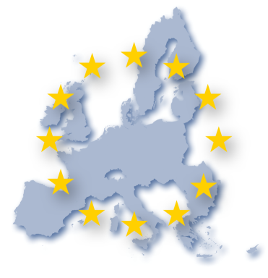
THANK YOU FOR YOUR ATTENTION
zsuzsanna.gyenes@jrc.ec.europa.eu
IPSC - INSTITUTE FOR THE PROTECTION AND SECURITY OF THE CITIZEN
ISPRA, ITALY
https://emars.jrc.ec.europa.eu/
https://minerva.jrc.ec.europa.eu
http://ipsc.jrc.ec.europa.eu/
http://www.jrc.ec.europa.eu/

