Slide 1
Improving the safety of Seveso-establishments in Finland by developing the accident investigation process
Tanja Heinimaa
Available in Finnish:
http://www.tukes.fi/Tiedostot/kemikaalit_kaasu/Onnettomuustutkinnan_vaikuttavuus_Seveso-laitoksilla.pdf

Slide 2
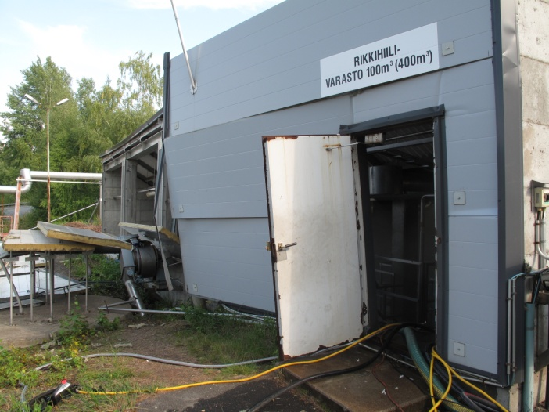
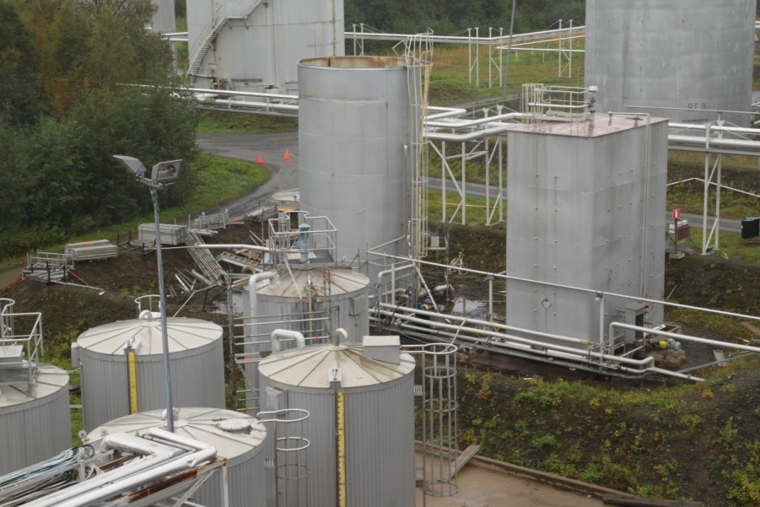
Backround
In Finland the competent authority (Tukes) investigates Seveso-accidents itself.
Smaller accident/ near-misses may be investigated only by the company (-> Tukes evaluates the report.)
  Learning from accidents has not been as effective as desired in the industrial handling and storage of dangerous chemicals globally.
  Recent research and practice has shown that it is possible to enhance and diversify the use of accident investigation (AI) methods.

Slide 3
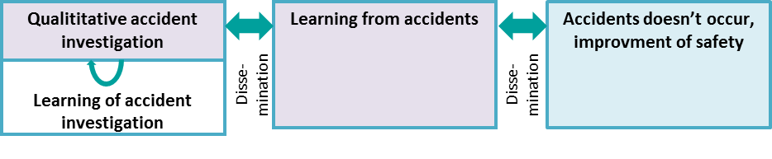
Hypothesis and challenges in Seveso-AI
  Without multi-disciplinary knowledge AI can be too narrow and superficial.
  Investigation of Seveso-accidents is not the only duty for any organization, and thus insuring sufficient expertise in AI process and methods is a challenge.
  Practices in investigation of Seveso-accidents varies a lot.

Slide 4
The purpose of the study
In Tukes the accident is described graphically by AcciMap in the AI report.
To improve safety and accident prevention in Seveso-establishments in Finland by developing the accident investigation (AI) at the Finnish Safety and Chemicals Agency (Tukes)
Accident investigation process
Accident investigation methods
List of good practices in AI
Recommended methods for Tukes
4

Slide 5
Methods and research questions
Method
Research question
1. Good practices in accident investigation?
AI process
Workshop in Tukes
2. What should we learn in Seveso-AI from the other organisations investigating accidents?
Seveso-survey
3. How are AI methods utilised in AI?
AI methods
OTKES-survey ^{(*}
4. Which AI methods are used and which of those are suitable for Tukes?
Interviews in Finland ^{(**}
5. How methods can be utilised in different phases of AI process?
Testing of AI methods
6. With which methods can be analysed also positive happenings?
^{(*} Safety investigation authorities/ boards in Finland (SIAF (=OTKES), Australia (ATSB), Canada (TSB), USA (NTSB), Norwey (AIBN), Sweden (SHK), England (RAIB, MAIB, AAIB)
^{(**} authorities in OHS, environment, rescue services, police, radiation and nuclear safety, The Finnish Motor Insurers' Centre and the Federation of Accident Insurance Institutions

Slide 6
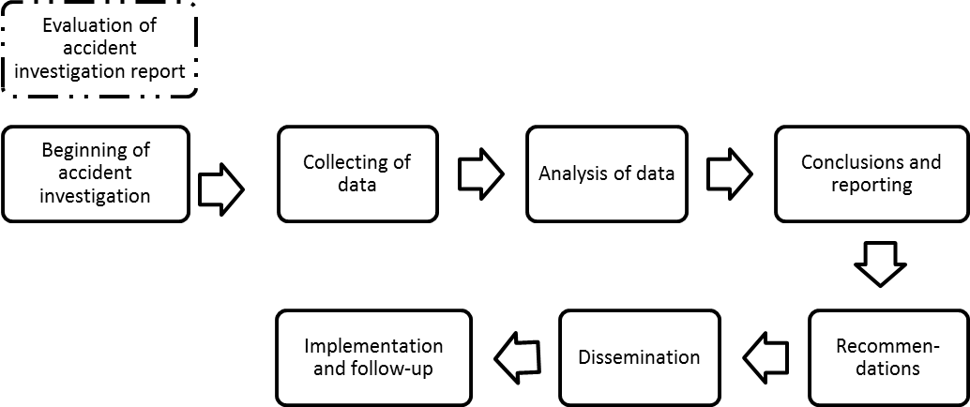
Phases of accident investigation process
In most countries the Seveso-authorities are not directly involved in the investigation. Instead they evaluate the report(s) done fx. by the company, the police or the independent body.
The list of good practices in each phases

Slide 7
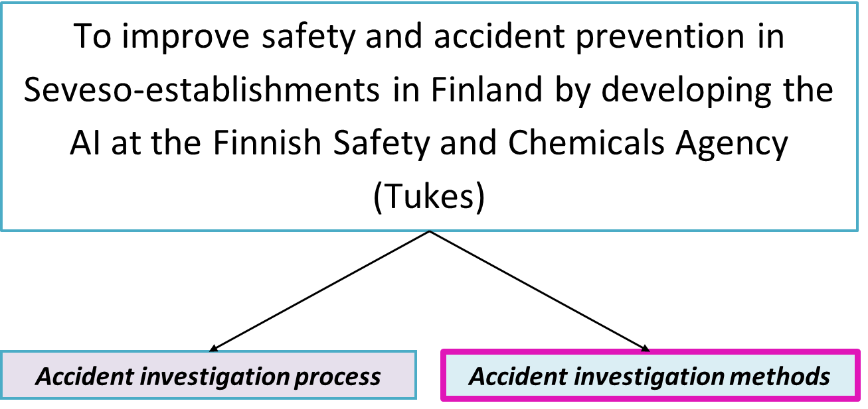
Results of surveys/ AI methods
Seveso | OTKES
AcciMap | AcciMap
AEB | AEB
Barrier analysis | Barrier analysis
Change analysis | Change analysis
Deviation investigation | Deviation investigation
DREAM (CREAM) | DREAM (CREAM)
Event and causal factor charting/ analysis | Event and causal factor charting/ analysis
Event tree analysis | Event tree analysis
Fault tree analysis | Fault tree analysis
FRAM | FRAM
GEMS | GEMS
MORT | MORT
MTO | MTO
Root cause analysis | Root cause analysis
Safety function analysis | Safety function analysis
SCAT | SCAT
SHELL | SHELL
STEP | STEP
TapRoot | TapRoot
TRIPOD | TRIPOD
Q: How familiar you are with the AI method?
Bow tie
mentioned is used
+ some other methods or procedures

Slide 8
Results of surveys/
Accident investigation methods
  The best known and most widely used methods are those based on traditional safety thinking.
  Professionals in AI are familiar and utilise different (fx. old and new) and even many methods in AI. Chosen method(s) depends fx. the accident and the aim of the investigation.
  AI methods are not always systematically utilised in AI.
  There is plenty to learn in Seveso-accident investigation.
  The benefits of different methods have been identified, but the knowledge of using them is not considered sufficient.

Slide 9
Testing of AI methods in Tukes
  Criterias for tested methods:
    Literature review and results of surveys
    The aim of the accident investigation in Tukes
    Accident model behind the method
  Six AI specialist in Tukes tested methods for the CS₂-explosion accident (Tukes investigated in 2008)
Deviation investigation
STEP
AcciMap
MTO
Fault and event tree analysis (-> Bow tie)
application of DISC-model (safety culture)
ESReDA Cube

Slide 10
Results of tests
  Deviation investigation: At the beginning of AI many deviations of normal can be listed -> many improvments. However the causality to the accident is not confident.
  STEP is particularly suitable at the beginning for the documentation of the collected data and to determine the need of additional data
  AcciMap is descriptive in the authority’s investigation report (sociotechnical levels, incl. legislation)

Slide 11
Results of tests
  MTO: With “why”-questions it is possible to recognise organisational reasons behind the accident quickly. Used method in Sweden.
  Fault tree analysis is suitable for analysis of technical reasons
  Event tree analysis can be applied fx. evaluation of the worst scenario (consequences?) and why the worst case didn’t occur (success?)
  Bow tie is an illustrative summary in communication especially for Seveso-supervision

Slide 12
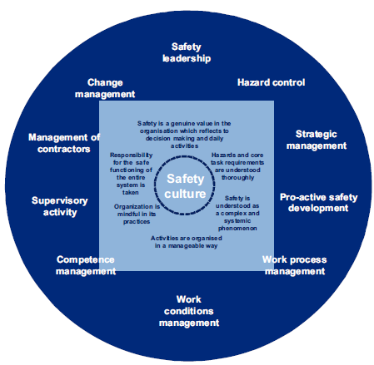
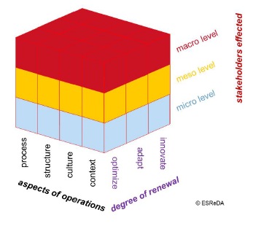
Results of tests
  DISC-model: Includes criteria for good safety culture. Could be essential to apply in general level (remember the aim of the Tukes-investigation).
  ESReDA-Cube: New perspective for learning of accidents.
Reiman T, Pietikäinen E, Oedewald P, Gotcheva N. System modeling with the DISC framework: evidence from safety-critical domains. Work 41 (2012) 3018-3025
http://94.199.118.186/Tiedostot/tutkimus/ESReDA_Cube.pdf

Slide 13
Results of tests
  The best methods for analysing successes in order to prevent accidents or minimise the consequences are barrier analysis, AcciMap, DISC-model and ESReDA Cube.

Slide 14
Accident investigation methods
  Without multi-disciplinary knowledge in AI and in AI methods it is not possible to utilise AI methods perfectly.
  None method can replace the need of multi-disciplinary knowledge in AI.
  None method is good for everything.
  Each method has positive influence on investigation.
  It is recommended to use different methods or utilise parts of those in each stage of AI process in order to insure qualitative and objective investigation.

Slide 15
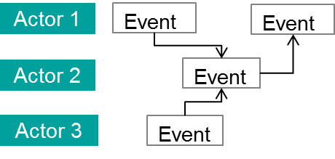
Recommendations for Tukes
STEP
  According to this study the most useful methods for Tukes in Seveso-accident investigation are STEP, AcciMap and application of the DISC-model.
  In order to analyse technical causes triangle of fire and test of hypotheses are important.
Compustible material
Hypothesis | Support | Does not support
Oxygen
Ignition source

Slide 16
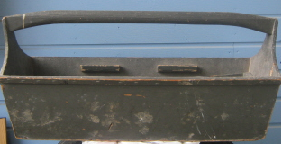
Tukes Toolbox – AI methods
Event and causal factor analysis
Root cause analysis
AcciMap
STEP
SHELL
Barrier analysis
DISC
MTO
Deviation investigation
ESReDA Cube
Fault tree
Event tree
Fire and explosure triangle
Bow tie
Testing of hypothesis

Slide 17
Recommendations for Tukes to improve lessons learnt
  Utilization of AI methods. Open mind for other methods than in our Tool box at the moment.
  Enough multi-discplinary knowledge available for AI (inl. ”Analysis” –phase)
  Regularly workshops at Tukes: ”How did we success in AI? Which methods we used? What to learn?”
  More co-operation with other AI-organisations in Finland and in other countries -> learning
  Improve the learning of accidents occured in other industry or abroad

Slide 18
Recommendations for Tukes to improve lessons learnt
  Active dissemination of results of AI in Seveso-supervising
  Improve the effectiveness of communication (incl. social media)

Slide 19
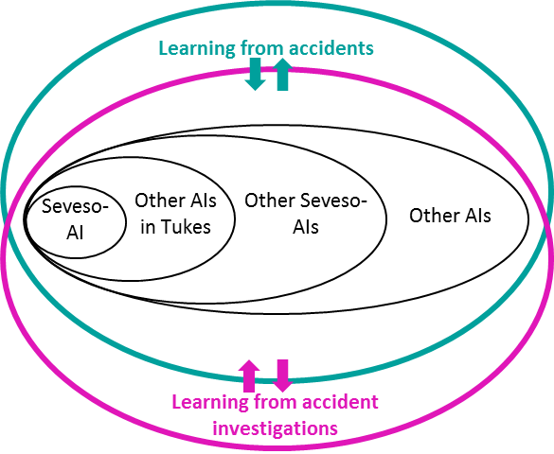
Conclusions

Slide 20
Conclusions
  In addition to learning from accidents it is essential to learn from AI process.
  Qualitative AI creates an opportunity to learn from accidents and improve the safety
  -> Good practices in AI (incl. the use of AI methods)
  In order to achieve qualitative AI it is recommended that co-operation in AI will be improved with other AI organisations‘ + dissemination, follow-up

Slide 21
Seveso- accident investigation in Tukes (Finland)

Slide 22
ACCIDENT INVESTIGATION PROCESS/ Common practices in Finland
Tukes as a Seveso authority in Finland investigates itself all major accidents that have occurred at Seveso-establishments. Tukes may co-operate with other authorities like occupational health and safety or environment authority, rescue services or the police. In some cases Tukes may also co-operate with Safety Investigation Authority. (In Finland the Safety Investigation Authority (SIAF, in Finnish OTKES) investigates all major accidents regardless of their nature as well as all aviation, maritime and rail accidents and their incidents.) It is also possible to ask for e.g. technical help or other expert assistance from other stakeholders.
One of the main difficulties in the accident investigation is lack of resources; Seveso inspectors are not able to concentrate only in the investigation but have other Seveso duties as well. In addition Seveso inspectors need more training on investigating routines and investigation methods.
There is not a special group at Tukes for accident investigation, instead all Seveso inspectors (13) might do it. It has been discussed whether the inspectors are objective and independent enough to investigate accidents that have occurred at the establishments they control. At Tukes the Seveso inspector doesn't investigate those accidents have occurred at the plants he/she is a contact person (colleagues do the investigation). On the other hand OTKES (Safety investigation authority) can evaluate the work of Tukes.
Tukes has a manual of accident investigation written in 2007; the process of accident investigation is described and guidelines are given on how to carry out the investigation.
Tukes investigates all the accidents that meet the Seveso criteria (Annex VI in the Seveso II directive; e.g. depends on the amount and the classification of the chemical release, if somebody is dead / 6 injured in the plant or one outside the plant, extent of the evacuation). In addition, Tukes may also investigate smaller accidents, incidents or near misses. The aim of the accident investigation is to prevent similar accidents, not to search guilty(/ies).
Usually Tukes investigates one or two accidents per year. In addition Tukes is informed of other smaller accidents by the operators and evaluates those reports. Finland has national register of incidents and accidents called VARO.

Slide 23
ACCIDENT INVESTIGATION METHODS/ Common practices in Finland:
There are three accident investigation methods described in the accident investigation handbook: AcciMap, STEP and MTO. However, the methods are often not utilised in the accident investigation process as well as they could be. Instead the investigation is usually based on the knowledge and skills of the investigators (normally two members in the investigation group) and accident is described graphically by means of the AcciMap only in reporting stage.
There hasn't been much training on the methods or even on accident investigation process. Normally the investigation is carried out in pairs, one being experienced and teaching the less experienced one. General understanding in the process safety group is that there is need to learn more about the accident investigation methods; e.g. when and how to use different methods.

