Slide 1
Seveso Capacity Building in European Neighbour Countries Project Methodology

Slide 2
The basic capacity building strategy
Building capacity to implement effective chemical accident prevention programmes should aim generally at:
Establishing a long-term vision, while using existing strengths to achieve measurable progress step-by-step over time.
Increasing a countries’ understanding of issues related to chemical accident prevention and preparedness
Improving the capacity of relevant institutions, agencies, industry and experts to address the risks of chemical accidents

Slide 3
Question Slide 1:
Does this make sense?
Would you add any other key principle?
Would you move remove or change the principles?
What kind of expectations would you have for this project?
Can we make a difference?
Can we give something back that’s sustainable?
Are there ways that we can work effectively with you?

Slide 4
A Multi-year approach based on a 5-point strategy
Project strategy
The current strategy for the ENPI-Seveso project will be developed on a “rolling” 2-3 year horizon
It has been based on a 5-point strategy developed from its experience with Accession Countries and the UNEP Flexible Framework
The strategy will be adjusted as experience and collaboration bring new ideas and improvements
Country strategy
Parallel bilateral and multilateral strategies are possible
Bilateral collaborations will be a core feature of the project
In addition, multilateral activities are foreseen
Some multilateral workshops will be driven by perceived need across countries
Others may be driven by needs identified through bilateral collaboration
A bilateral collaboration may evolve into a multilateral (e.g., regional or subregional collaboration)

Slide 5
Question Slide 2
Does this sound like a good way to begin?
Does the planning have adequate/too much flexibility for addressing individual country needs?
Does your experience suggest that a bilateral or a multilateral approach is better?
Are there obvious regional or subregional groupings that we might focus on sooner rather than later?

Slide 6
The 4-point strategy
Establish a long term vision
Establish a realistic starting point with the country
Identify a few main areas where progress is needed and possible
Establishing expert resources and networks

Slide 7
Strategy Point 1
1. Establish a long term vision
A systematic structured conceptual approach to chemical accident prevention is necessary, i.e., the Seveso approach
In many cases, the country already has the vision and then the need is to help a country address gaps and/or difficulties in implementation.

Slide 8
Seveso Directive: Quick Summary
Obligation | Dutyholder (s)
Art. 6 – Notification | Operator
Art. 7 – Major Accident Prevention Policy (MAPP) | Operator
Art. 8 – Domino Effects | Competent authority
Art. 9 – Safety reports | Both
Art. 11 – Emergency Plans | Both
Art. 12 – Land Use Planning | Competent authority
Art. 13 – Information to the Public | Both
Art. 14 – Accident information & follow-up | Both
Art. 15 – Accident report to EC | Competent authority
Art. 16 – Committee of Competent Authorities | EC & Competent authorities
Art. 18 – Inspections | Competent authority
Art. 19 – Major accident reporting system | EC
Art. 19 – Inventory of Seveso sites | EC & Competent authorities
Art. 21 – Harmonised criteria & guidelines | EC
¹EC = European Commission

Slide 9
Strategy Point 2
2. Establish a realistic starting point with the country
What does legislation offer and who has to implement it?
How well does industry know how to manage chemical risks safely?
What is the government’s experience with chemical safety?
What government agencies have a role?
What chemical risks are the government & the people most worried about?
What tools and experts in risk analysis are available?
What chemical accidents are known to have happened in the past?
Etc.
Mechanisms foreseen
Initially- a survey of the country situation as a first step.
Subsequently - Bilateral meetings with key stakeholders, possibly in combination with workshops

Slide 10
Question Slide 3
Do you have any advice on using the Seveso model in the Neighbour Countries that you might know?
Where might it be possible to make a difference early on?
What do you think will be the highest priorities? greatest needs?
Could there be any resistance to using the Seveso model?
Which countries might have the most/the least experience with Seveso and the Flexible Framework?
Do you have any experience with successes or failures in trying to make some of the Seveso elements work in various places?

Slide 11
Question Slide 4
Are there particularly important advantages and disadvantages that should be identified early on?
What have been key factors in places affecting project success or failure where you have trained and collaborated?
What have been some key challenges and how did you overcome them?
What other country factors (regulatory, social, historical, culture, etc.) might be leveraged for greater success of the project?

Slide 12
Strategy Point 3
3. Identify a few main areas where progress is needed and possible
Typical capacity building needs often includes some of the following:
Building awareness and understanding of chemical accident risks Establishing a common definition of chemical accident risks and a common starting place to improve among government & industry actors
Establishing and prioritizing the country’s chemical accident risks – What are they? Where are they? How high are the risks?
Hazard identification and risk analysis –Training on theory and techniques, access to analytical tools with training/pilot projects on practical use for specific scenarios/sites, inspections and safety reports
Inspections and safety audits. Training on inspection & auditing– what to look for (on-site training), basics of safety management systems, using risk analysis, e.g., layers of protection & other methods

Slide 13
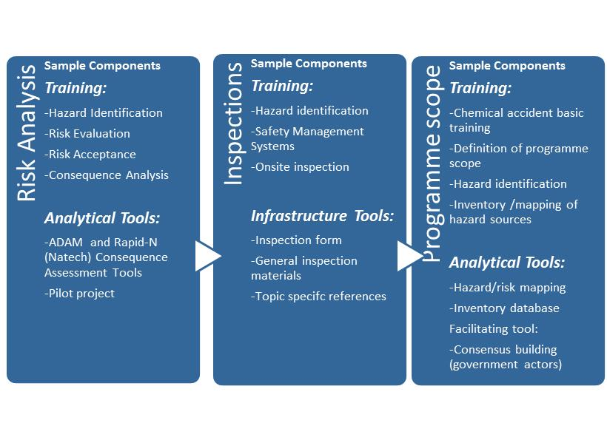
Example of capacity building strategies for different themes

Slide 14
Examples of past country strategies
Country 1: Limited competency and experience with chemical accident prevention
Country 2: Moderate competency but limited experience with chemical accident prevention
Country 3: Moderate competency and experience with chemical accident prevention

Slide 15
Question Slide 5
Does this seem to be an approach that is: realistic? adequately flexible? too ambitious? How would you improve it?
What is your opinion on what some of the common starting points might be?
What do you think will be the highest priorities be for the countries?
What might be their greatest needs?
Questions 2 - 4 are repeats from Question Slide 3

Slide 16
Strategy Point 4
4. Establishing expert resources and networks. A new, challenging area – building/ maintaining adequate chemical safety expert resources
Creating ongoing access to expert resources through
analytical tools, especially for hazard identification and consequence analysis
central reference points for existing good practice and lessons learned
creating mechanisms to facilitate ongoing and future expert exchange and knowledge sharing nationally, regionally, and globally
ad hoc consultation for crisis situations.

Slide 17
Tools in Development
Developed or in development
Minerva Web Portal giving access to chemical accident prevention knowledge and Tools
Geographic Information System – Area Risk Analysis (GIS-ARA)
Accident Damage Assessment Model (ADAM)
Rapid Natech Risk Mapping Tool: RAPID-N
Accident Information and Data Analysis (AIDA)
eMARS Light (part of AIDA)
Future development if needed
eSPIRS Light and Risk Mapping (Qualitative Ranking System)

Slide 18
Question Slide 6
What ideas do you have for building a solid sustainable result in our partner countries?
Are there some concepts we are missing in this overall description?
What ideas do you have on resources and networks that could useful and should be made to our partner countries?
In your experience, what has worked and what hasn’t worked in terms of making a difference?

Slide 19
Where are we now?
Year 1 of the project is underway and involves
Getting to know the countries (profile development)
Starting with a questionnaire to each country (~February 2015)
Natech risk workshop for all countries (2nd semester 2015)
Development of a multi-year strategic plan (underway)
Tools development
Long term project (started in 2011) to give online to risk analysis tools especially for consequence analysis for specific sites
Will be useful for site risk analysis, and area specific emergency and land-use planning

Slide 20
Summary – Initial Project Milestones
Survey of European Neighbour Countries on Chemical Accident Prevention Perspective (March-May 2015, Analysis)
Expert brainstorming workshop (March 2015)
Begin face-to-face dialogue with countries (bilateral or regional workshop, meetings – TBA) – by June 2015
Survey analysis completed and distributed – September 2015
First phase strategy for capacity building for 2016-2017, based on above inputs - (September 2015)
Beta test version of the GIS-Area Risk Analysis/ADAM tool - ~Nov 2015
Natech risk analysis workshop – ~Nov 2015

Slide 21
Country survey on chemical accident prevention
Developed and disseminated by the JRC with DG-ECHO advice
The survey will ask one government focal point to facilitate answers for the country (some exceptions possible)
The survey will seek the government perspective
Contacts will be asked about the involvement of other ministries besides their own, but not necessarily in detail
Objective is to establish a basis for a starting point with the country on its chemical risk management situation
Questions about legislation, hazardous sites, perceived risks & needs.
The analysis will be shared with the country and open for its comment.
A general analysis will be eventually published but without identifying countries mainly, but possibly some information if the country agrees.
Follow-up on a regional or bilateral basis (next 18 months)

Slide 22
In summary, our expectations …
A self-driven flexible programme – objectives will in large part be driven by common needs and specific interests of each country, within practical limits
For the EC contribution
General availability of experts as a source of knowledge and contacts
Technical methods and tools for analysis and implementation – workshops, tools, projects
Consultation and support as possible for specific problem areas
Contribution from countries
Collaborative approach – development of trust atmosphere to enable identifying solutions together
Openness to multi-stakeholder involvement – e.g., co-operation across ministries, dialogue with industry
Motivated and hard-working partners in project collaborations

Slide 23
Question Slide 7:
What kind of expectations would you have for this project?
Can we make a difference?
Can we give something back that’s sustainable?
Are there ways that we can work effectively with you?
Repeated from Question Slide 1

