Slide 1
Capacity-building from the perspective of the ECE Industrial Accidents Convention
Virginia Fusé,
UNECE secretariat
Ispra
26/03/2015

Slide 2
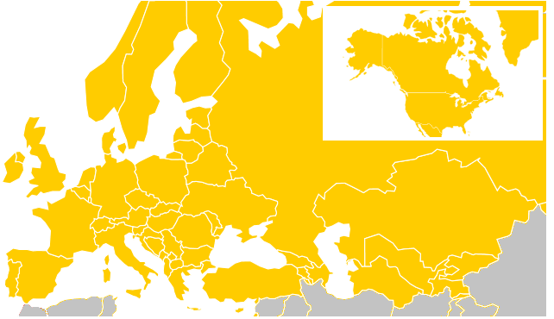
The ECE region

Slide 3
National stakeholders for the implementation of the Convention
Prevention
Preparedness
Response
Ministry of Environment
Ministry of Interior / Emergency Situations
Other ministries
Regional and local authorities
Industry
Public

Slide 4
Cross-border cooperation in the Convention

Slide 5
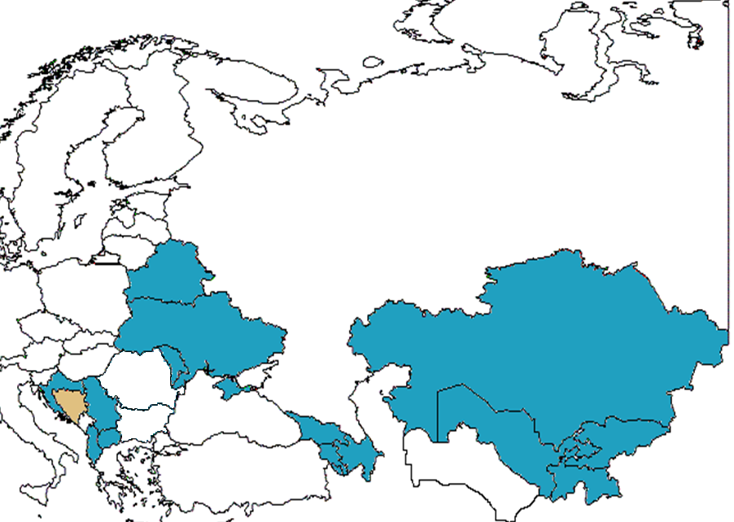
The Assistance Programme: a decade of needs-driven approach
Countries in the ECE Industrial Accidents Assistance Programmer

Slide 6
Our decade of experience
Assistance Programme countries became Parties to the Convention
Pre-accession and association processes to the EU (approximation to Seveso Directive) strengthened the related political support for these developments.

Slide 7
Our decade of experience Examples
Armenia
International workshop on the project “Assistance to Raising Knowledge on Industrial Safety at Universities” (2013)
Azerbaijan
National training session on identification of hazardous activities (2010)
Georgia
High level awareness raising mission and experts meeting toward the implementation of the Strategic Approach within the ECE Convention on the Transboundary Effects of Industrial Accidents (2013)
Moldova and Ukraine
Danube Delta Project (from 2011)

Slide 8
Our decade of experience A specific example of activity
Training session on safety management systems as part of safety reports in Serbia (13 and 14 November 2013)
Serbia submitted a project proposal, together with the self-assessment
Assistance was needed to explain to the operators and to colleagues from other authorities, the reasoning behind safety reports and, the structure of the safety management system
40 representatives of national authorities and industry participated in the training

Slide 9
Assessment of identification of hazardous activities, Country 1
Limited and incomplete provisions for identification of hazardous activities in the existing legislation. Different organisations have lists of industrial activities do exist BUT they are not harmonized to the provisions of the convention
No system adopted by the legislation for the classification of hazardous substances. Classification of data is not harmonized
Information is available however dispersed over several authorities and needs update
Limited coordination and cooperation among involved authorities regarding data collection and analysis

Slide 10
Assessment of identification of hazardous activities, Country 2
Official list of potential HA consists of 8 potential hazardous activities identified for names of chemicals, and quantity mentioned in the Annex I
Location criteria taken in consideration for the water path on national territory. Not all installations identified have directly transboundary effects
No worst-case scenario methodology was used, therefore the clear number of potential HA in transboundary context is not clearly identified yet

Slide 11
Assessment of prevention 1
There seems to be an element of a preventative regime implemented, namely the development of an ecological study within the environmental permitting procedure, however these are not detailed based on common rules
Competent authorities seem to be little aware of the requirements of the Convention in the area of prevention

Slide 12
Assessment of prevention 2
Current legislation seems not to require operators of hazardous activities to demonstrate the implementation of preventative measures in compliance with the Convention
Capacity is lacking in several areas (staff for drafting legislation, capacity for processing requests for permits, inspections/supervision, and staff capacity for processing permits)

Slide 13
Assessment of preparedness
An overall national plan exists. The different ministries have/need to have their own plans. There is however a need for improvement and coordination between the plans because they are separated
There are no on- and offsite emergency plans or they are not enough coordinated between the responsible authorities and or they are not in compliance with the convention
Response is mainly based on a case by case basis
Not for all ministries and their authorities it is clear how to operate during an accident. There is a lack of procedures for response

Slide 14
Assessment of response
Not all responsible stakeholders are involved in the stage of preparedness and consequently also the response. This hinders the effectiveness
The effectiveness of adequate response actions is hindered by a lack of capacity and capabilities (staff, equipment, information)
Bilateral agreements with neighbouring countries exist. It is however unclear if and to which extent they include aspects regarding preparedness, response and mutual assistance in compliance with the Convention
A communication mechanism exists. The roles and responsibilities of key players in cases of communication in emergency situations are however unclear

Slide 15
What did we learn
Common need of cooperation and coordination among different actors
Ownership/motivation -> The essential political situation and the political support towards industrial accidents prevention policies is essential. Without this the progress is only left to the good will of the focal points
Too many international actors working separately → need cooperation and coordination also between international organisations

Slide 16
Suggestions
Focal points and competent authorities: sharing information
Colleting information from countries: avoid duplication e.g. ask countries to share information contained in the implementation reports under the Convention
Attention to wording: do not focus on “Seveso” vocabulary (not always familiar with it)
Identify/involve the “right” persons in the right authorities
Take account of ongoing projects, including those by EU member states
Cooperation with other international organisations and partners

Slide 17
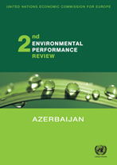
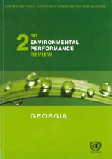
Additional information
http://www.unece.org/environmental-policy/environmental-performance-reviews/reviewed-countries.html

Slide 18
Thank you for your attention
http://www.unece.org/env/teia/welcome.html
teia.conv@unece.org

